Slide 1
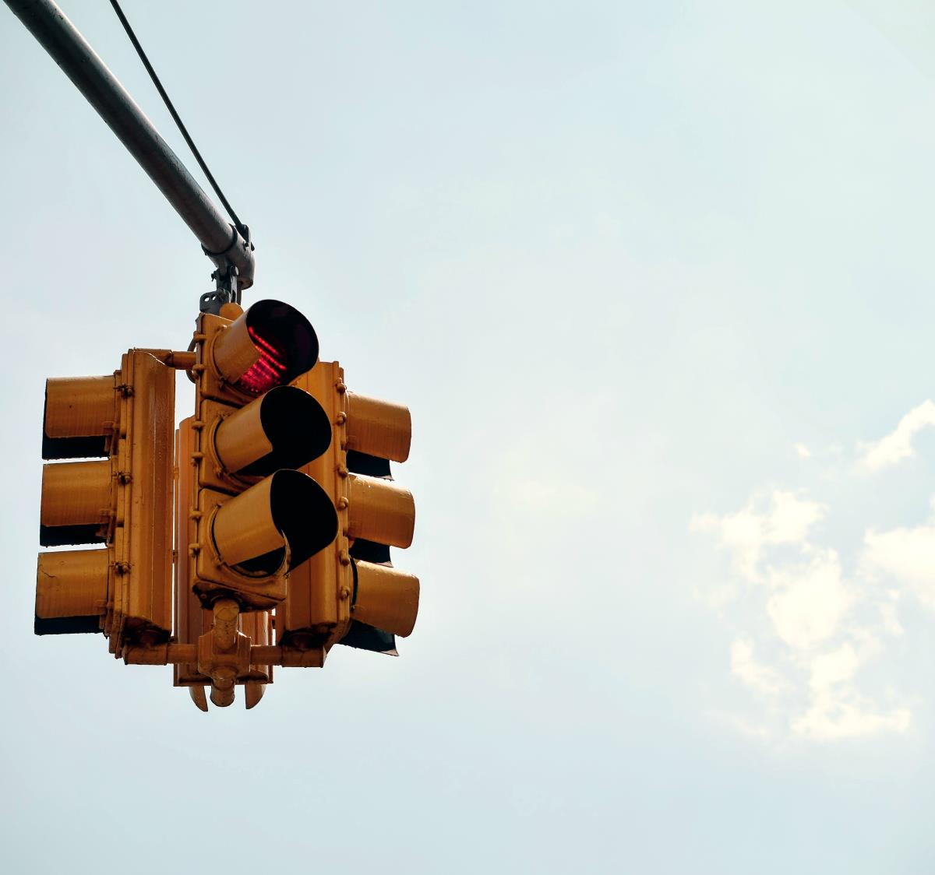
TRAFFIC LIGHT
CONTROL USING 555 TIMER IC

Slide 2
ABSTRACT
The utilization of a 555 timer integrated circuit (IC) in traffic signal control circuits offers an effective and versatile solution for managing vehicular and pedestrian traffic at intersections. This project explores the implementation of a traffic signal system using the 555 timer IC, a classic component known for its simplicity and adaptability in timing applications. The project's primary focus is on creating a functional, yet educational, traffic light control system.

Slide 3

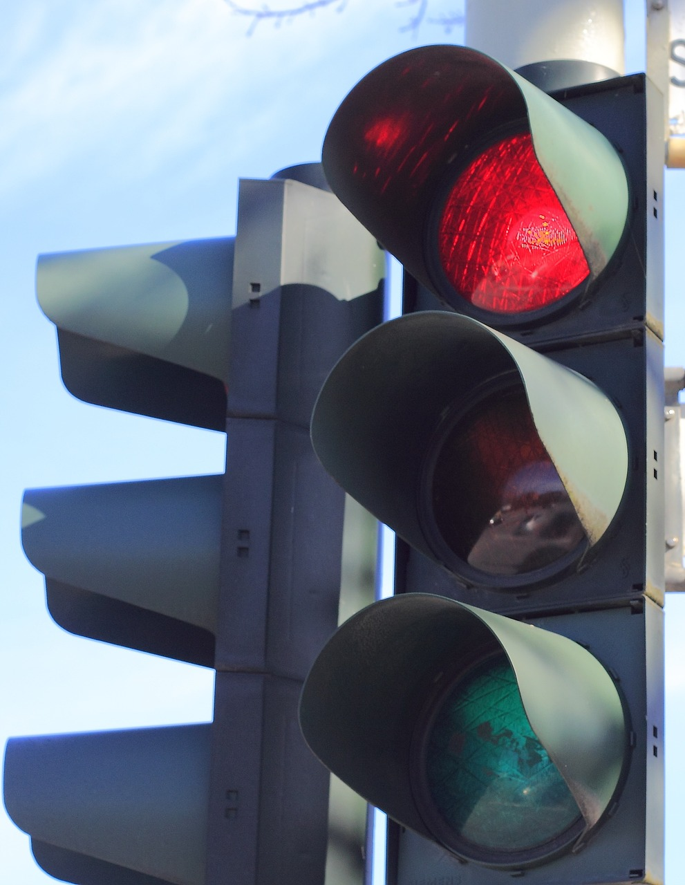
INTRODUCTION
Traffic lights are crucial elements of urban and suburban transportation systems, serving as visual signals to regulate the flow of vehicular and pedestrians. Traffic lights are a fundamental part of modern transportation infrastructure, playing a crucial role in maintaining order and safety on the roads. Advances in technology continue to refine their effectiveness and efficiency in managing increasingly complex traffic scenarios.
Notes:
Photo by Charlotte Boyle on Unsplash

Slide 4
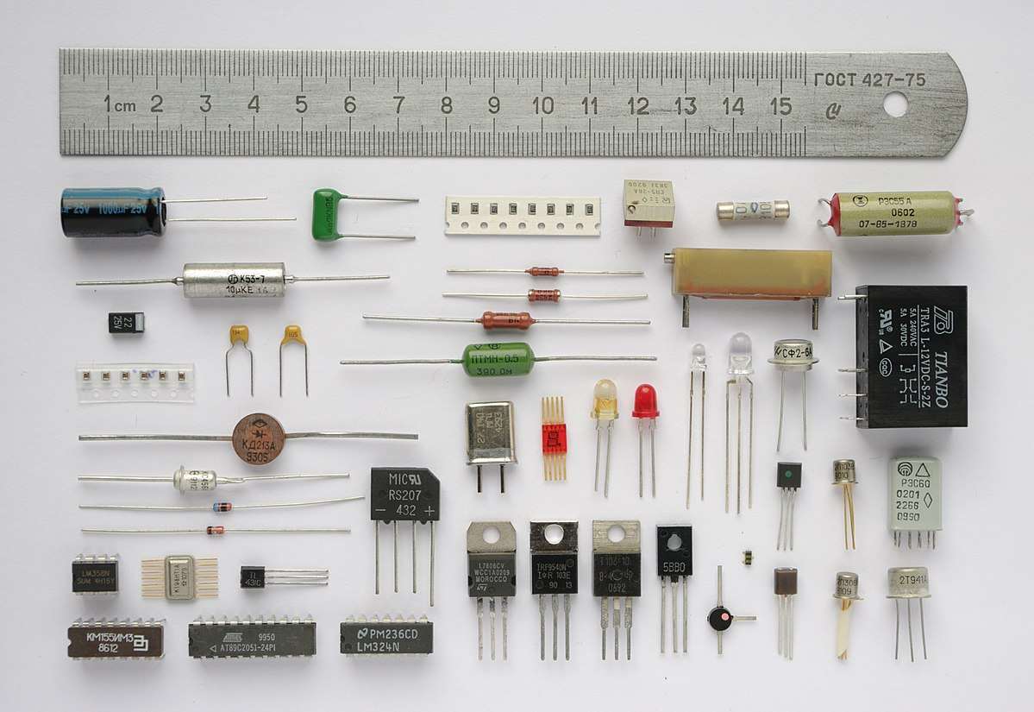
Project components
555 Timer IC
Breadboard
Resistors
Capacitors
3 LEDs (red, green, yellow)
3v batteries
L

Slide 5

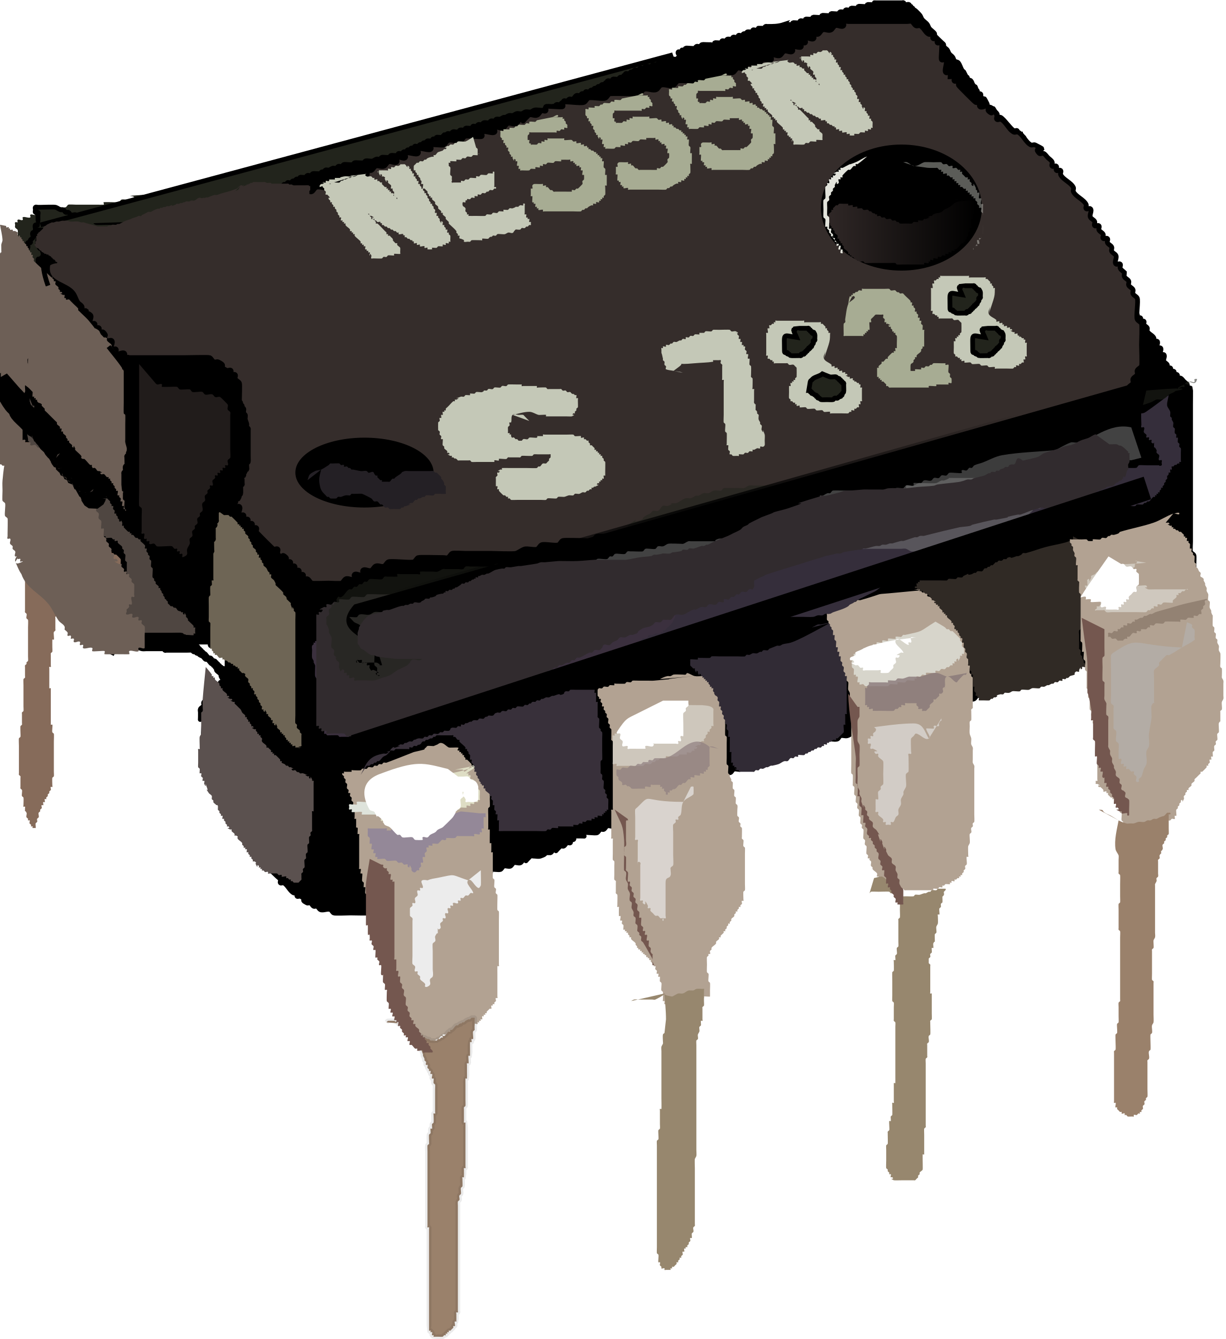
555 TIMER IC
The 555 timer IC (integrated circuit) is a widely used analog device that has been a staple in electronics since its introduction in 1972 by Signetics (now a part of ON Semiconductor). The 555 timer is versatile and can be configured to perform various tasks, making it a popular choice for a wide range of electronic projects. Here are key aspects about the 555 timer:
Its internal block diagram comprises a comparator, flip-flop, and discharge transistor, orchestrating its functionality across three distinct modes
Notes:
Photo by Ihor Dvoretskyi on Unsplash

Slide 6
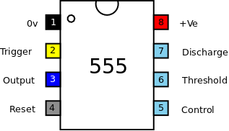
PIN CONFIGURATION
Pin 1 is the Ground (GND), providing the circuit's reference point.
Pin 2, TRIG, is the trigger input that initiates the timing process.
Pin 3, OUT, is the output that produces the square wave signal.
Pin 4, RESET, is an active-low input that resets the internal flip-flop when pulled low.
Pin 5, CV (Control Voltage), allows external voltage adjustment to modify timing characteristics.
Pin 6, THRS (Threshold), is a comparator input determining the switching point.
Pin 7, DISCH (Discharge), connects to an external capacitor for timing control.
Pin 8, VCC, is the supply voltage pin, providing power to the IC
This Photo by Unknown Author is licensed under CC BY

Slide 7
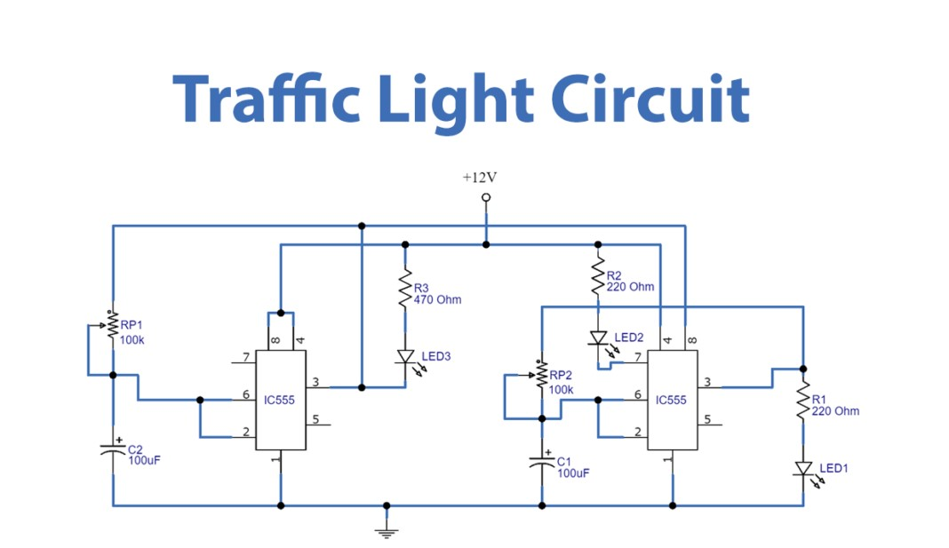
CIRCUIT DIAGRAM

Slide 8
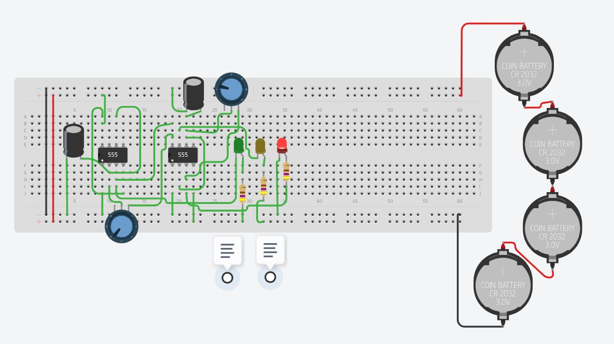
Simulation Results:
RED LED is ON

Slide 9
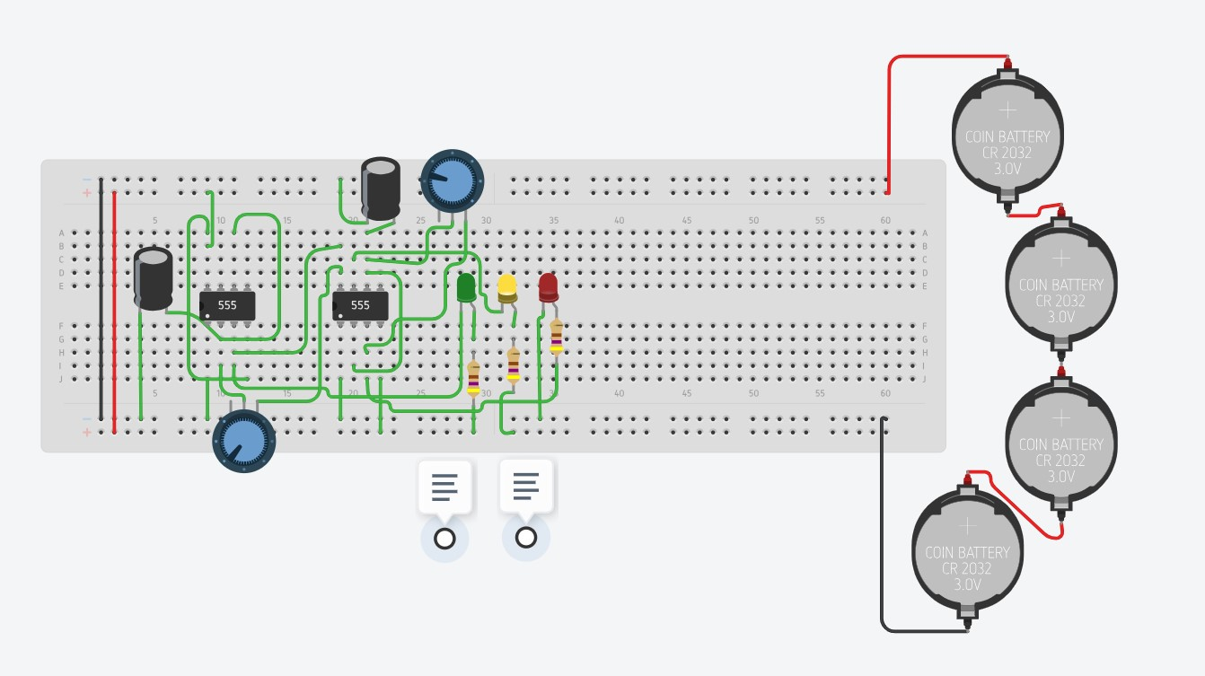
YELLOW LED IS ON

Slide 10
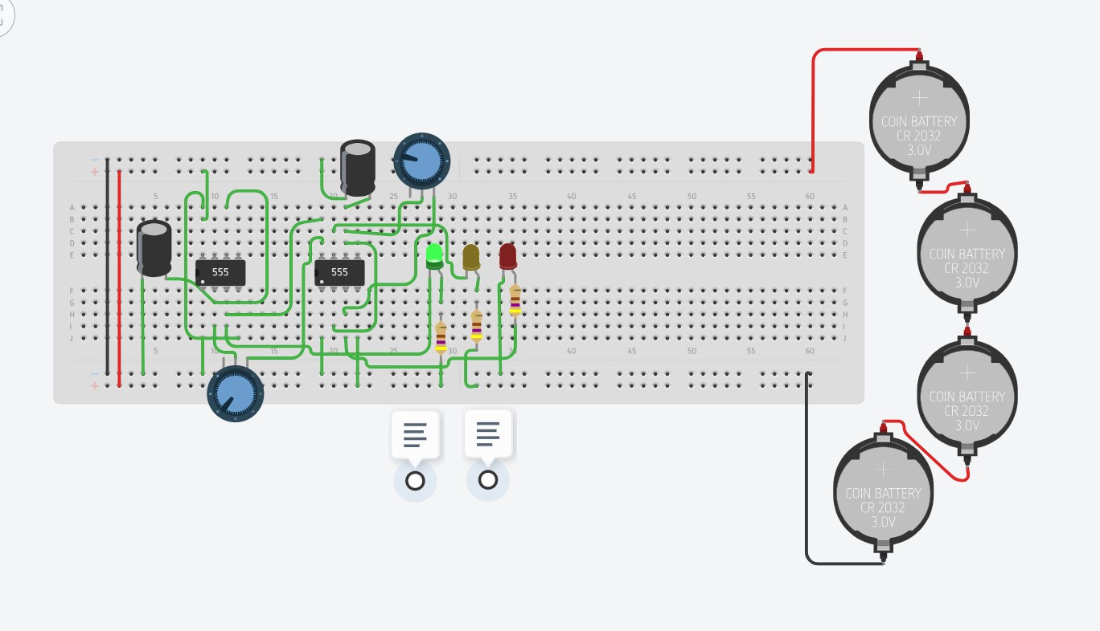
GREEN LED IS ON

Slide 11
Astable mode of 555 Timer IC
The operation of a traffic light using a 555 timer in astable mode involves configuring the 555 timer as an oscillator to generate a continuous square wave.
Oscillator Action:
Astable mode means it's not stable or still; it's constantly oscillating.
The 555 timer generates a pulsing output, creating a rhythmic, repeating pattern.
Timing Components:
Astable mode involves using external resistors (R1, R2) and a capacitor (C) to determine the timing characteristics of the oscillator.
These components set the frequency (how fast it oscillates) and the duty cycle (the ratio of time it spends in the high state).
Notes:
Photo by Ihor Dvoretskyi on Unsplash

Slide 12
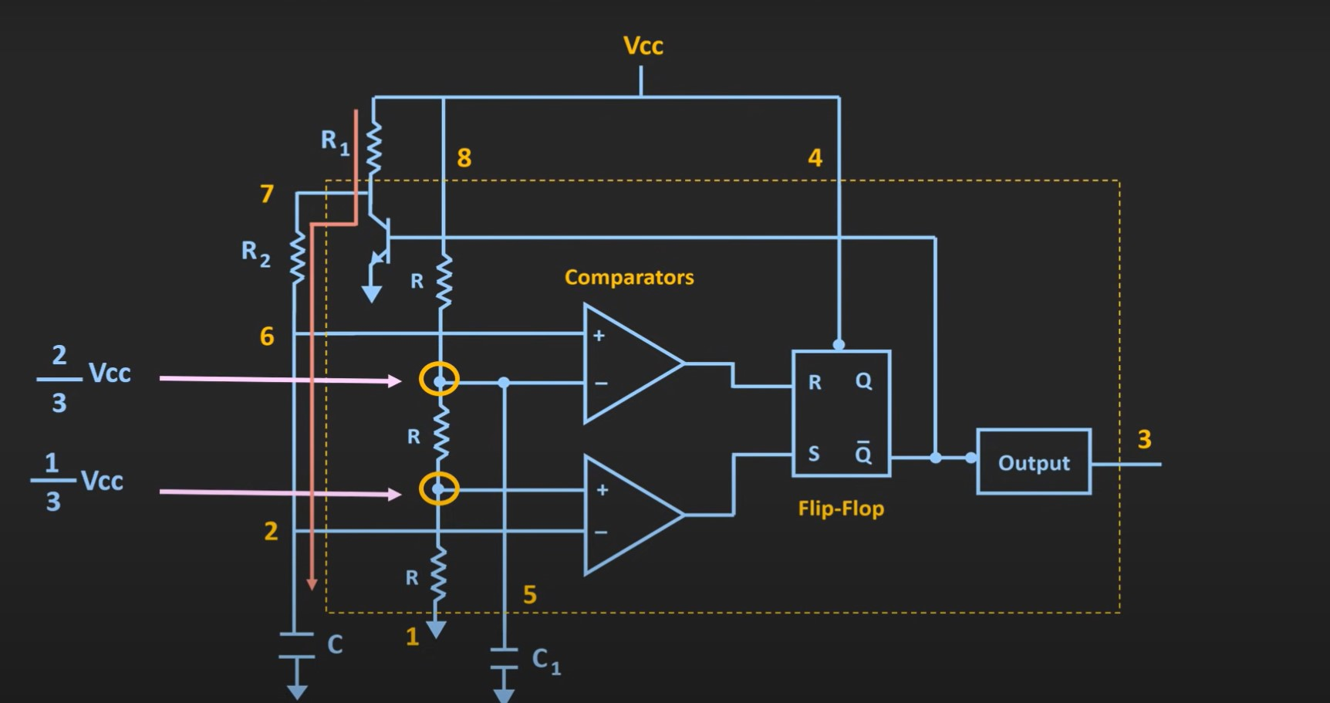
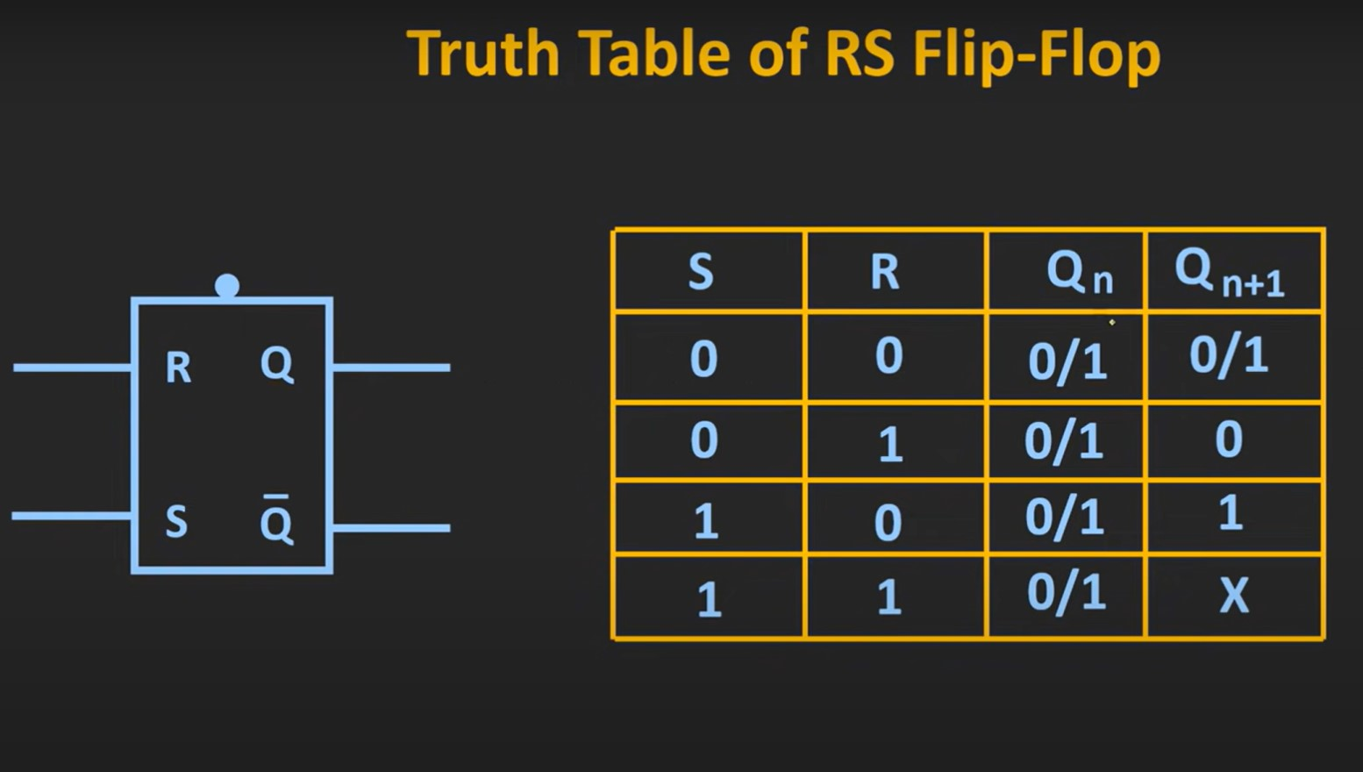

Slide 13
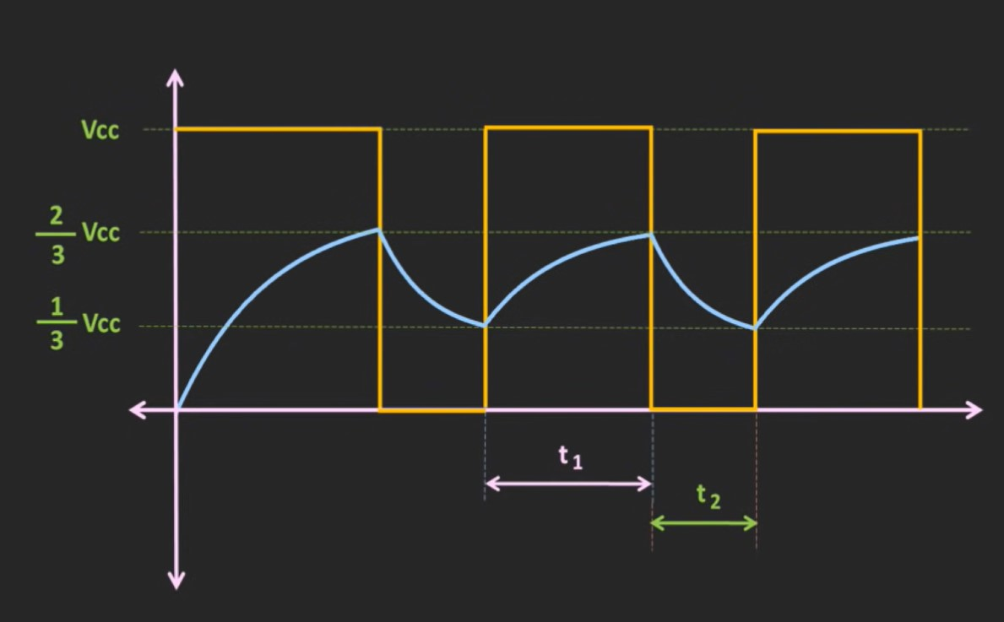
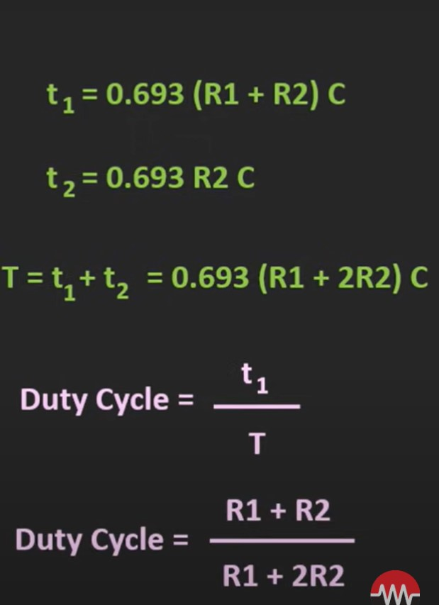
Frequency and Duty Cycle:
The timing components control how quickly the 555 timer switches between high and low states (frequency).
They also determine the percentage of time it spends in the high state compared to the total cycle time (duty cycle).
Time Period (T ):
T=0.693×(R1​+2×R2​)×C
T is the time period of one complete cycle of the square wave output.
1R1​ and 2R2​ are the resistances connected to the 555 timer.
C is the capacitance connected to the 555 timer.
OUTPUT WAVE FORM:
The output is square wave form in astable mode from 555 timer IC.

Slide 14

How it works
Upon powering on the circuit, the output of IC1 (red LED corresponding to IC1) is ON because the voltage at PIN-3 (Trigger Pin) is less than 1/3rd of the supply voltage.
The green LED (corresponding to IC2) does not turn ON initially because the output of IC2 is at a high state.
The capacitor of IC2 (corresponding to the yellow LED) begins to charge.
As soon as the voltage across the capacitor of IC2 reaches 2/3rd of the supply voltage (Threshold Voltage), the output of IC2 turns OFF, activating the discharge pin. The yellow LED glows during this discharge phase

Slide 15
Before the capacitor of IC2 fully discharges, the voltage across the capacitor of IC1 (corresponding to the red LED) reaches 2/3rds of the supply voltage.
The output of IC1 turns OFF, turning off the red LED corresponding to IC1.
The yellow LED (corresponding to IC2) turns OFF as a result of the output of IC1 turning OFF.
Simultaneously, the green LED (corresponding to IC2) turns ON because the output of IC2 is now in a high state.
This cycle repeats again and again
Notes:
Photo by Ihor Dvoretskyi on Unsplash

Slide 16
CONCLUSION:
The 555 timer's role in traffic signal control not only exemplifies its electronic prowess but also underscores its practical impact on urban infrastructure. By providing an efficient means to regulate traffic flow, the 555 timer contributes significantly to the safety, organization, and overall functionality of transportation systems.
As technology advances, the 555 timer remains a timeless and reliable component, demonstrating its versatility across a myriad of applications. From waveform generation to traffic signal control, the 555 timer continues to play a vital role in shaping the landscape of electronic design.

Slide 17
SUBMITTED BY:
Y.RISHI - 22EEB053
A.AKHIL SAGAR- 22EEB0B38
T.LIKHITH-22EEB0B37

Slide 18
THANK YOU

